Slide 1



A Mini Project on A DEEP LEARNING FRAMEWORK FOR SPEED DETECTION AND VEHICLE DETECTION
CMR Technical Campus
UGC AUTONOMOUS
Accredited by NAAC with A Grade
Approved by AICTE, New Delhi and Affiliated to JNTU, Hyderabad
Department of Computer Science And Engineering
Presented by
Yerram Shreya , 207R1A05P9
A.Nitish Bharadwaj 207R1A05J8
P.Sai Krishna 207R1A05M8
Under the Guidance of
Mrs. S aparna
(Assistant Professor)

Slide 2
Abstract
In recent times, there has been a drastic change in people’s lifestyles and with an increase in incomes and lower cost of automobiles there is a huge increment in the number of cars on the roads which has led to traffic and commotion
Existing system uses certain mechanism like RADAR, LIDAR, Camera based system and magnetic based system for vehicle detection and speed detection but, those are less accurate because these system are sensitive towards weather conditions and direction of vehicle and high cost. To overcome this we are proposing a novel deep learning based solution which can affectively detect vehicle and speed .To achieve this we are training Haar cascade algorithm with Fine-Grained vehicle dataset. This dataset consists of different vehicles information with proper labelling to train object(vehicle) and velocity is measured using python script among other deep learning algorithms Haar cascade is faster and captures images faster.
With this solution we can accurately detect vehicle and it’s speed so that traffic will under control and further accidents can be reduced.

Slide 3
Existing System
There are various existing systems for speed detection and vehicle detection, ranging from simple manual methods to complex automated systems. Here are a few examples:
Radar-based speed detection systems: These use radar technology to measure the speed of a moving vehicle by bouncing radar waves off the vehicle and measuring the time it takes for the waves to return.
LIDAR-based speed detection systems: These use LIDAR (Light Detection and Ranging) technology, which works by emitting a laser beam and measuring the time it takes for the beam to bounce back off an object

Slide 4
Existing System
DISADVANTAGES:
There are several disadvantages of speed detection and vehicle detection technologies, including:
Limited accuracy: Speed detection and vehicle detection technologies are not always 100% accurate. Factors such as weather conditions, vehicle type, and calibration issues can affect the accuracy of these systems.
High cost: Implementing speed detection and vehicle detection technologies can be expensive, requiring the installation of specialized equipment and infrastructure. This can be a significant barrier for smaller organizations or municipalities with limited resources.

Slide 5
Proposed System
A proposed system for speed detection and vehicle detection would use sensors and cameras to detect the presence of vehicles and measure their speed. The system would be placed at strategic locations, such as near intersections or along highways. Once a vehicle is detected, the system would measure its speed.
The data collected could be used for traffic management, enforcement of speed limits, or identifying areas where improvements in road safety are needed. If a vehicle is detected traveling at an unsafe speed or violating traffic laws, the system could trigger alerts or notifications to law enforcement or other relevant authorities.

Slide 6
Proposed System
Advantages
Road safety: Speed detection helps in ensuring that drivers do not exceed the speed limit, which in turn reduces the number of accidents on the road and makes the roads safer for everyone.
Traffic management: Speed detection can help in managing traffic flow, particularly during peak hours. By monitoring the speed of vehicles, traffic authorities can adjust traffic signals and timings to ensure smooth traffic flow and reduce congestion.
Improved fuel efficiency: Speed detection can help drivers maintain a consistent speed, which can improve fuel efficiency and reduce fuel consumption.
2/10

Slide 7
Requirements
SOFTWARE REQUIREMENTS
Coding language : Python
Operating system : Windows 7 and Above
Camera : Internet protocol camera
HARDWARE REQUIREMENTS
Hard disk : SD card (1GB)
Processor : Pentium IV or higher
RAM. : 256MB
2/10

Slide 8
Novelty
Technologically advanced speed calculators installed that effectively detect cars on the road and calculate their speeds
To implement the above idea two basic requirements, need to be met which are the effective detection of the cars on roads and their velocity measurement.
For this purpose, we can use OpenCV software which uses the Haar cascade to train our machine to detect the object, in this case the car.

Slide 9
Proposed System Architecture
Input
Vision Sensors
Pre processing
Background Substraction
Transfer Image to System
Speed Detection
Authority
Learning Engine
Vehicle Detection
Open CV Software
Haar
Cascade

Slide 10
MODULES
Camera or Sensor Module: A camera module is typically used to capture video footage or images of the road or traffic.
Image Processing and Computer Vision: Image processing and computer vision techniques are employed to analyze the captured video frames or images and detect vehicles within them.
Data Storage and Management: Depending on the project requirements, a module for storing and managing the collected data may be necessary. This can involve databases, cloud storage, or local storage solutions.
Object Detection Frameworks: Popular deep learning frameworks like TensorFlow, PyTorch, or OpenCV provide pre-trained models and APIs for object detection.
User Interface and Display: A user interface module can be implemented to provide a graphical interface for the system, displaying the detected vehicles, their speed, and any other relevant information.

Slide 11
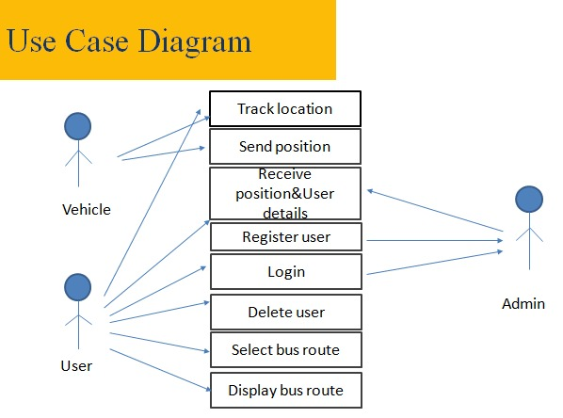

Slide 12
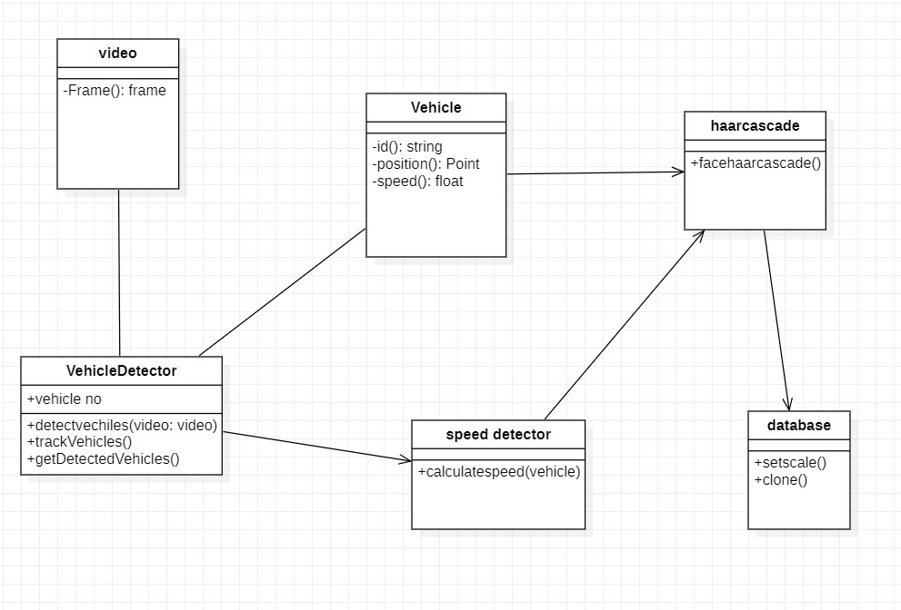
Class Diagram

Slide 13
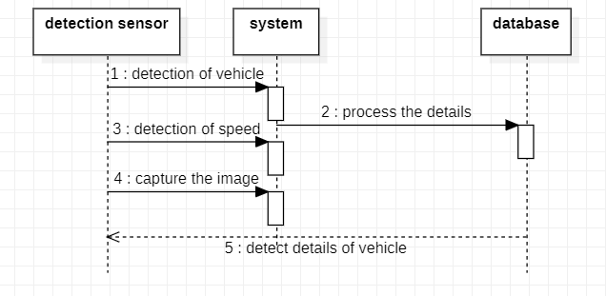
Sequence Diagram

Slide 14
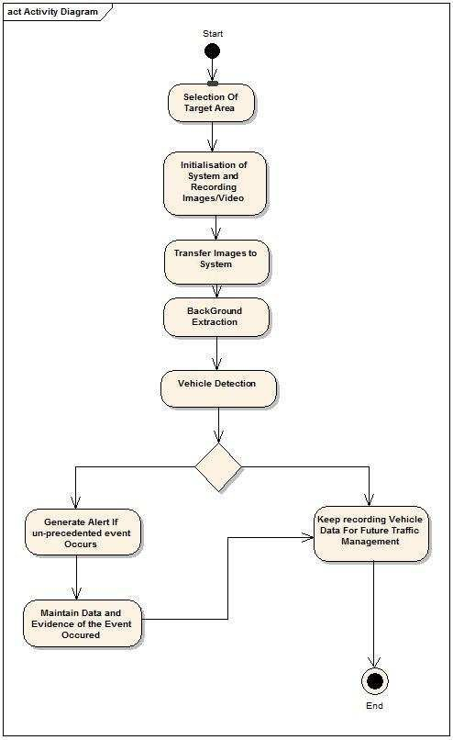
Activity Diagram

Slide 15
SAMPLE CODE
for(x,y,w,h) in cars:
cv2.rectangle(img, (x,y), (x+w,y+h), (0,255,0),2)
center_x=(2*x+w)/2
center_y=(2*y+h)/2
#print(center_x,center_y)
dist1=((wide*668.748634441)/w)
#print("Distance from car:",round(dist1,2),"m")
roi_gray = gray[y:y+h,x:x+w]
roi_color = img[y:y+h,x:x+w]
dist0=((wide*668.748634441)/w)
actual_dist=dist0*(width/2)/668.748634441
#print("Actual Distance:",actual_dist)
if flag is True and int(round(center_x)) in (range(0,80) or range(400,480)):
start=time.time()
flag=False
#print("Start:",start)

Slide 16
#print("Start:",start)
if flag is False and int(round(center_x)) in range(int(round(width/2))-10,int(round(width/2))+10):
end=time.time()
time_diff=end-start
#print("End:",end)
flag=True
s_flase
#print("Time Difference:",time_diff)
if time_diff>0 and s_flag==True:
velocity=actual_dist/time_diff
#print(round(start),round(end))
vel_kmph=round(velocity*3.6,2)
print("Speed:",vel_kmph,"kmph") print("Distance from car:",round(dist1,2),"m")
s_flag=False
cv2.line(img,(int(width/2),0),(int(width/2),height),(255,0,0),2)
cv2.imshow('frame',img)
if cv2.waitKey(1) & 0xFF == ord('q')
break
cap.release()
cv2.destroyAllWindows()

Slide 17
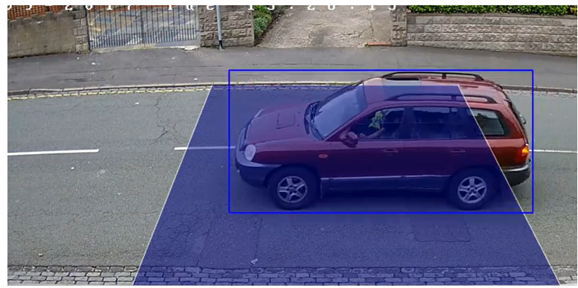
results

Slide 18
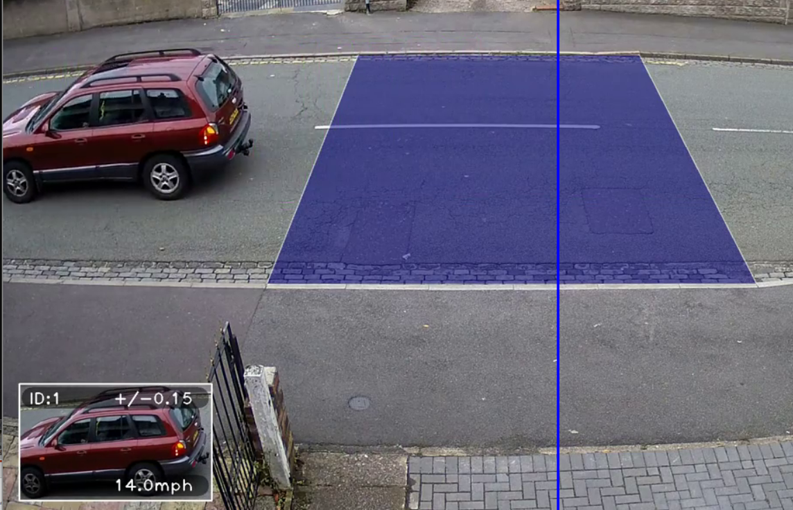

Slide 19
Conclusion
We conclude that, open CV is more efficient technology .
In this project aim is to create a bigger haar cascade since bigger the haar cascade developed, more the number of vehicles that can be detected on the roads. Better search algorithms can allow a faster search and better detection of these vehicles for better efficiency.

Slide 20
Future scope
Every development has some drawback or lack of necessary feature that emerges with the usage and need. the project can be developed even more by adding vehicle detection wireless sensing networks will be another intresting which will open up much more application areas.
Advanced image processing algorithms and libraries could be used so that system can be used efficiently even during unfavourable lighting conditions and during night time as well.

Slide 21
refrences
Raad Ahmed Hadi1,Ghazali Sulong and Loay Edwar George.“Vehicle detection and tracking techniques :A concise review”.
Signal & Image Processing : An International Journal (SIPIJ)
Vol.5, No.1, February 2014. Z. Wei, et al., "Multilevel Framework to Detect and Handle .
Vehicle Occlusion," Intelligent Transportation Systems,IEEE Transactions on, vol. 9, pp. 161-174, 2008.
Nishu Singla,“Motion Detection Based on Frame.

Slide 22
Github link
https://github.com/yerramshreya/VehicleDetection-And-SpeedDetection/tree/main

Slide 23
Thank You
2/10

